Slide 1

2GA3 Tutorial #10
DATE: November 26th, 2021
TA: Jatin Chowdhary

Slide 2
I’m Back
Guess who’s back
  Back again
    Shady’s back
      Tell a friend
We’re gonna catch up on missed content
  Lucky for us, the stuff is easy peasy
    I love ¢a¢h£
      Doesn’t everyone?

Slide 3
So What Happened?
Question: Why did we cancel last week (November 19th, 2021)?
Answer: My left side (arm, shoulder, wrist, etc.) was killing me
  It’s (slowly) getting better now
  But last week it was horrible
    Couldn’t even walk

Slide 4
Black Friday
Today is Black Friday
Go out, get some deals
  Good deals
Now’s a good time to take a break (Just before exams)
  Get some rest this weekend
    Do some shopping
Personally, I’m getting a new phone and changing ISPs
  ISP = Internet Service Provider
Starting Monday, November 29th, it’s grind time
  3 weeks ‘till 2GA3 exam

Slide 5
Another Re-Structure
We’re going back to the old format
  Turns out, everyone prefers this format
The new (old) format is:
  Administrative stuff
  Review questions/material
  Tutorial questions
We’re gonna take it nice and easy
  ‘‘Doctor’s orders’’

Slide 6
Recordings Are Back
Someone deleted the lectures/tutorials, but I was able to restore them
  I’ve downloaded the lectures; in case it happens again
We need to change read/write permissions
Took some time to recover everything
  Today’s tutorial will be slow
    But then again, ‘‘doctor’s orders’’

Slide 7
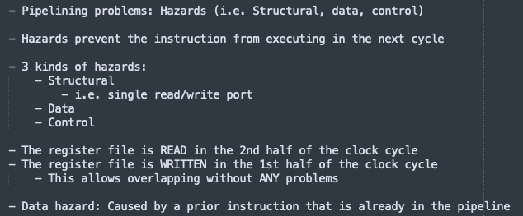
Videos Are Coming
I’m working on the scripts right now
  And it’s Black Friday so I need a break

Slide 8
More Content
And more content is planned
We got 3 weeks till the final exam
  Final exam = 50%
Now’s the time to push through
  Take a break this weekend
    And then floor it, starting Monday

Slide 9
Ground Up
Tutorials stand on their own 2 feet
  So even if you’re behind in lecture, you should still come to tutorial, because you’ll learn something
    And you don’t need to know anything
Also:
  Slides are gonna be updated to be ‘‘whole’’
    This means going back and doing all the tutorial questions and then putting them in the slides
  Everything will be done from the ground up

Slide 10
Listen Carefully

Slide 11
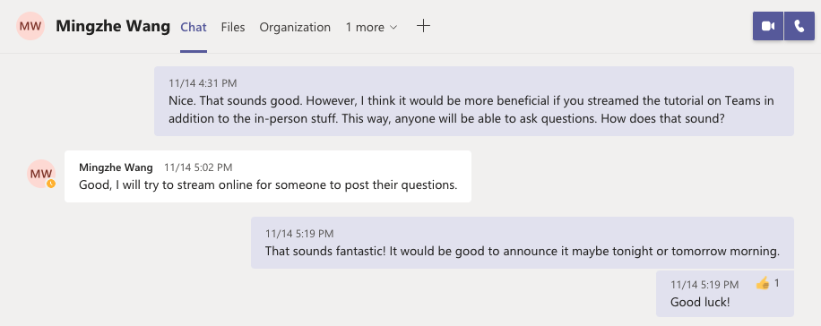
Always ASK!
If you want something done a particular way, ASK!
  And if I can’t get it done, I’ll find someone or something else to get it done
    i.e.

Slide 12
Always ASK!
Life lesson: Everything in life can be renegotiated and reneged
  Everything.
    i.e. Loans, payments, due dates, deadlines, etc.
So don’t be afraid to ask
  ‘‘You don’t get what you don’t ask for’’
    This applies to all facets of life
      i.e. Getting a loan, applying for a job, etc.

Slide 13
Next Week
The last tutorial for 2GA3 is:
Friday, December 3rd, 2021
  That’s next week
    7 days from now
Should you come?
  I promise I’ll make it worth your while
    Yes you should
      Can’t say more...

Slide 14
Questions?
Comments?
Concerns?

Slide 15
Quick Review
I need a general idea of where you’re all at
  Who looked at last week’s content (Tutorial #9)?
  How comfortable are you with the stuff on cache?
    Not ca$h, but cache
      C.R.E.A.M
  How do you feel about the 50% final exam?
    Other than pumping out slides and videos, what else can I do?
Now that I know what your story is, I can navigate the swamp better
  ‘‘You can never underestimate how wrong you can be’’

Slide 16
Cache Review
Why do we need cache?
  Pretend your cooking pizza
    Is it better if you have all the ingredients on the table where you can easily access them?
    OR
    Is it better if you have to run to the pantry everytime you need an ingredient (i.e. Sauce, cheese, etc.)
    OR
    Is it better if you have to run to the store for each ingredient, a different store each time?

Slide 17
Cache Example
Obviously, it’s better if the ingredients are immediately available and accessible on the table
  Less time spent on acquiring ingredients, the better
    We can spend more time on cooking
Generally, the further we have to travel FROM the CPU, the L _ _ _ _ _ it takes to retrieve data
  i.e.
    Ingredients on the table = Registers
    Ingredients in the pantry = Cache
    Ingredients from neighbours = RAM
    Ingredients from grocery store = HDD
      HDD/SDD = S_ _ _ _ _ _ _ _ storage
    Import ingredients from Italy = Magnetic tapes stored in a sketchy basement

Slide 18
L1/L2/L3 Cache
Question: What is the difference between L1, L2, and L3 cache?
  Somebody in lecture
Answer: The simple answer is we want to cut down on ‘‘travel time’’. The less we need to use RAM/HDD, the better
  Generally the rule is: L1 » L2 » L3
    L1 is faster than L2, which is faster than L3
  But they also serve a special purpose for parallel processing and concurrency
    But this is way beyond the content of this course

Slide 19
Main Idea
The main idea is: Going into memory is a pain
  It is expensive, slow, and should be avoided at all costs
Hence, programs and data are loaded ahead of time to avoid going back and forth between CPU and storage
  Waiting for stuff to be loaded requires stalls
    Memory stalls = Wasted CPU cycles
      L _ _ _ performance
From a high level, this is all you need to know about cache

Slide 20
Learning
Time
(Straighten Up)

Slide 21
Outline
Quickly review last week’s content to bring everyone up to speed
  I’m not gonna assume everyone reviewed tutorial #9
    I now know better; do not ASSUME
      ‘‘You can never underestimate how wrong you can be’’
First question from Tutorial #10
  It’s gonna make so much sense!

Slide 22
Questions?
Comments?
Concerns?

Slide 23
Tutorial Question #1
Question: Caches are important to providing a high-performance memory hierarchy to processors. Below is a list of 64-bit memory address references, given as word addresses.
0x03, 0xb4, 0x2b, 0x02, 0xbf, 0x58, 0xbe, 0x0e, 0xb5, 0x2c, 0xba, 0xfd
  For each of these references, identify the binary word address, the tag, and the index given a direct-mapped cache with 16 one-word blocks. Also list whether each reference is a hit or a miss, assuming the cache is initially empty.

Slide 24
Precursor
Important things to know:
  Direct-mapped cache
  Cache is initially empty
  In total: 16 one-word blocks
Given the word address, the question wants the binary word address, the tag, the index, and whether each reference is a hit or a miss.
  Next slide

Slide 25
Binary Address
Given the word address, the question wants the binary word address, the tag, the index, and whether each reference is a hit or a miss.
  The binary word address is the word address, but in binary
    Convert word address to binary (0x → 0b)
Word Address | Binary Address
0x03 | 0b00000011
0xb4 | 0b10110100
0x2b | 0b00101011

Slide 26
Index
Question: How to calculate the index size?
  We have to use the cache size
  Recall: given a direct-mapped cache with 16 one-word blocks
    So what’s the size of the cache? Rather, how many blocks are in this direct-mapped cache?
Answer: The size of the index is: 4
  16 = 2^{n} (What is n?)
    n = index size (in bits)
      Start from least significant bits

Slide 27
Tag
Question: So what’s the size of the tag?
  We have to use the index size to compute the tag size
    Recall: The size of the index is 4
      And if we only have 8 bits to work with, and 4 are used for the index, then the remaining 4 are used for the tag
Answer: The size of the tag is: 4
  8 – 4 = 4
    Start tag from where index left off

Slide 28
Putting It All Together
So the index is the 4 bits from the right, or the least significant bits
  The tag is 4 bits after the index
Word Address | Binary Address | Tag | Index
0x03 | 0b00000011 | 0 | 3
0xb4 | 0b10110100 | b | 4
0x2b | 0b00101011 | 2 | b

Slide 29
Hits/Misses
Question: How do we know if something is a cache hit or cache miss?
  Cache hit means requested data was found in the cache and can be quickly brought back
  Cache miss means that the data was not found in the cache and now we need to go to the next level in the memory hierarchy
Answer: Look at the index and tag
  Index tells you where the data is located
    Tag tells you if there is a ‘‘match’’
  Homework: Figure it out!

Slide 30
Tutorial Question #2
Question: Consider an Intel microprocessor with a 16 Kbyte unified L1 cache. The miss rate for this cache is 3% and the hit time is 2 CCs. The processor also has an 8 Mbyte, on-chip L2 cache. 95% of the time, data requests to the L2 cache are found. If data is not found in the L2 cache, a request is made to a 4 Gbyte main memory. The time to service a memory request is 100,000 CCs. On average, it takes 3.5 CCs to process a memory request. How often is data found in main memory? Assume we also know L2 hit time = 15 CCs and Main hit time = 200 CCs.

Slide 31
Pizza Time!
Precursor: Think back to our Pizza making example
  Assume that ingredients for the pizza are scattered across: The table, pantry, basement, neighbour’s house, and the grocery store
    The quickest is: Table
    The slowest is: Grocery store
  So, if I wanted to calculate the time it takes to make a pizza, minus cooking time, what do I do?
    Time spent on gathering ingredients is included
      Next slide!

Slide 32
Pizza Time!
Precursor: Example of cooking time:
  Opening packaging
  Spread sauce on the base
  Grate cheese, but the grater is in the pantry
    Run to the pantry, and then grate cheese
  Cut onions, mushrooms, etc.
  Decide to add pineapples
    We don’t have any, so we ask the neighbour
      Run to the neighbour’s house
      He doesn’t have any, so we run to the grocery store
Question: Out of all this stuff what slows us down the most?

Slide 33
Pizza Analogy!
Precursor: Think about it this way
  Working on the table/counter is like working with registers
    i.e. Cutting vegetables, spreading sauce, etc.
  Running to the pantry to grab the grater is like fetching data from L1 cache
    Takes time, but generally very quick
  Checking with the neighbour’s if they have pineapples is like checking L2 cache if the data we need is there
    If the neighbour’s don’t have pineapples, then we gotta run to the grocery store, which is the most time consuming
      Fetching data from main memory is also time consuming

Slide 34
Time Is Of The Essence
Precursor: Total time?
  So, the total time to make a pizza is:
    Time spent unwrapping stuff, spreading sauce
    Time spent running to the pantry
    Time spent grating cheese
    Time spent checking with the neighbour
    Time spent running to Whole Foods
  Similarly, if something isn’t available in L1 cache, we check L2 cache, then we check main memory (RAM)

Slide 35
Tutorial Precursor #2
Precursor: Whenever you do a question like this, you wanna separate the information for L1, L2, LN, main memory (RAM), etc.
  L1
    Hit time = 2
    Miss rate = 3% = 0.03
  L2
    Hit time = 15
    Hit rate = 15% = 0.15
    Miss rate = 1 – 0.15 = 0.85 (or 85%)
  RAM
    Next slide

Slide 36
Tutorial Precursor #2
Precursor: Whenever you do a question like this, you wanna separate the information for L1, L2, LN, main memory (RAM), etc.
  RAM (Main Memory)
    Hit time = 200
    Miss penalty = 100,000
  We know that the average memory request is 3.5
And the equation we need is:
Average memory access time = Hit Time +
(Miss Rate * Miss Penalty)

Slide 37
Tutorial Precursor #2
Precursor: But before we solve this, you need to understand that if there’s a miss in L1, then we need to check L2.
  So the Miss_Penalty of L1 is the AMAT of L2
    Does everyone understand this?
  Recap:
    If there is no hit in L1, then we need to check L2. So the time it takes to check L2 is the Miss_Penalty of L1

Slide 38
Tutorial Answer #2
Answer: We need our equation:
  Note:
    AMAT = Average Memory Access Time
    HT = Hit Time
    MR = Miss Rate
    MP = Miss Penalty
AMAT = HT + (MR x MP)

Slide 39
Tutorial Answer #2
Answer: Let’s color it up!
  AMAT = HTL1 + (MRL1 x MPL1)
  MPL1 = AMATL2
  AMATL2 = HTL2 + (MRL2 x MPL2)
  MPL2 = AMATRAM
  AMATRAM = HTRAM + (MRRAM x MPRAM)

Slide 40
Tutorial Answer #2
Answer: Let’s do it ourselves

Slide 41
THE END

